Slide 1

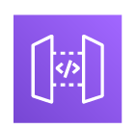
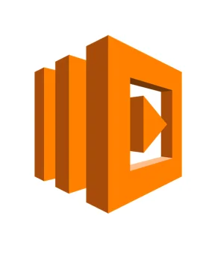

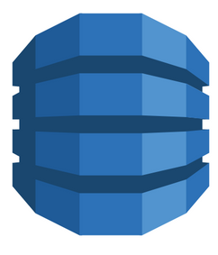

AWS Infra Architecture
Project 3 : HR Automation
Amazon
s3
Amazon
Amplify
Amazon
API Gateway
Amazon
Lambda Function
Amazon
DynamoDB
Amazon
IA Management

Slide 2
Ressources :
- (Video) https://www.youtube.com/watch?v=7m_q1ldzw0U&t=681s + GPT
App URL:
https://dev1570.d1uhueq8jnmzqc.amplifyapp.com/
API Gateway URL :
https://pt9lf9uefa.execute-api.us-east-1.amazonaws.com/dev
DynamoDB ARN :
arn:aws:dynamodb:us-east-1:757247860792:table/Project3Table

